Slide 1
Blockchain Introduction By Dr. Norman Guo

Slide 2
The Origin of Blockchain

Slide 3
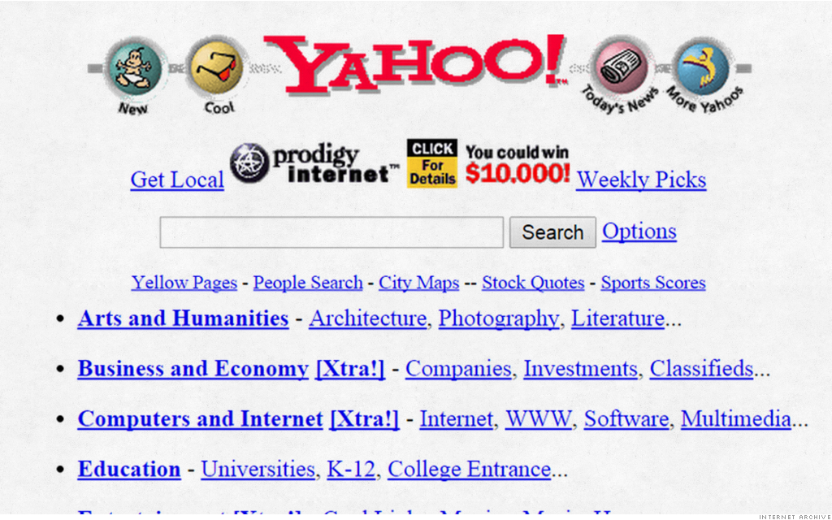
Internet of Information (Web 1.0)

Slide 4
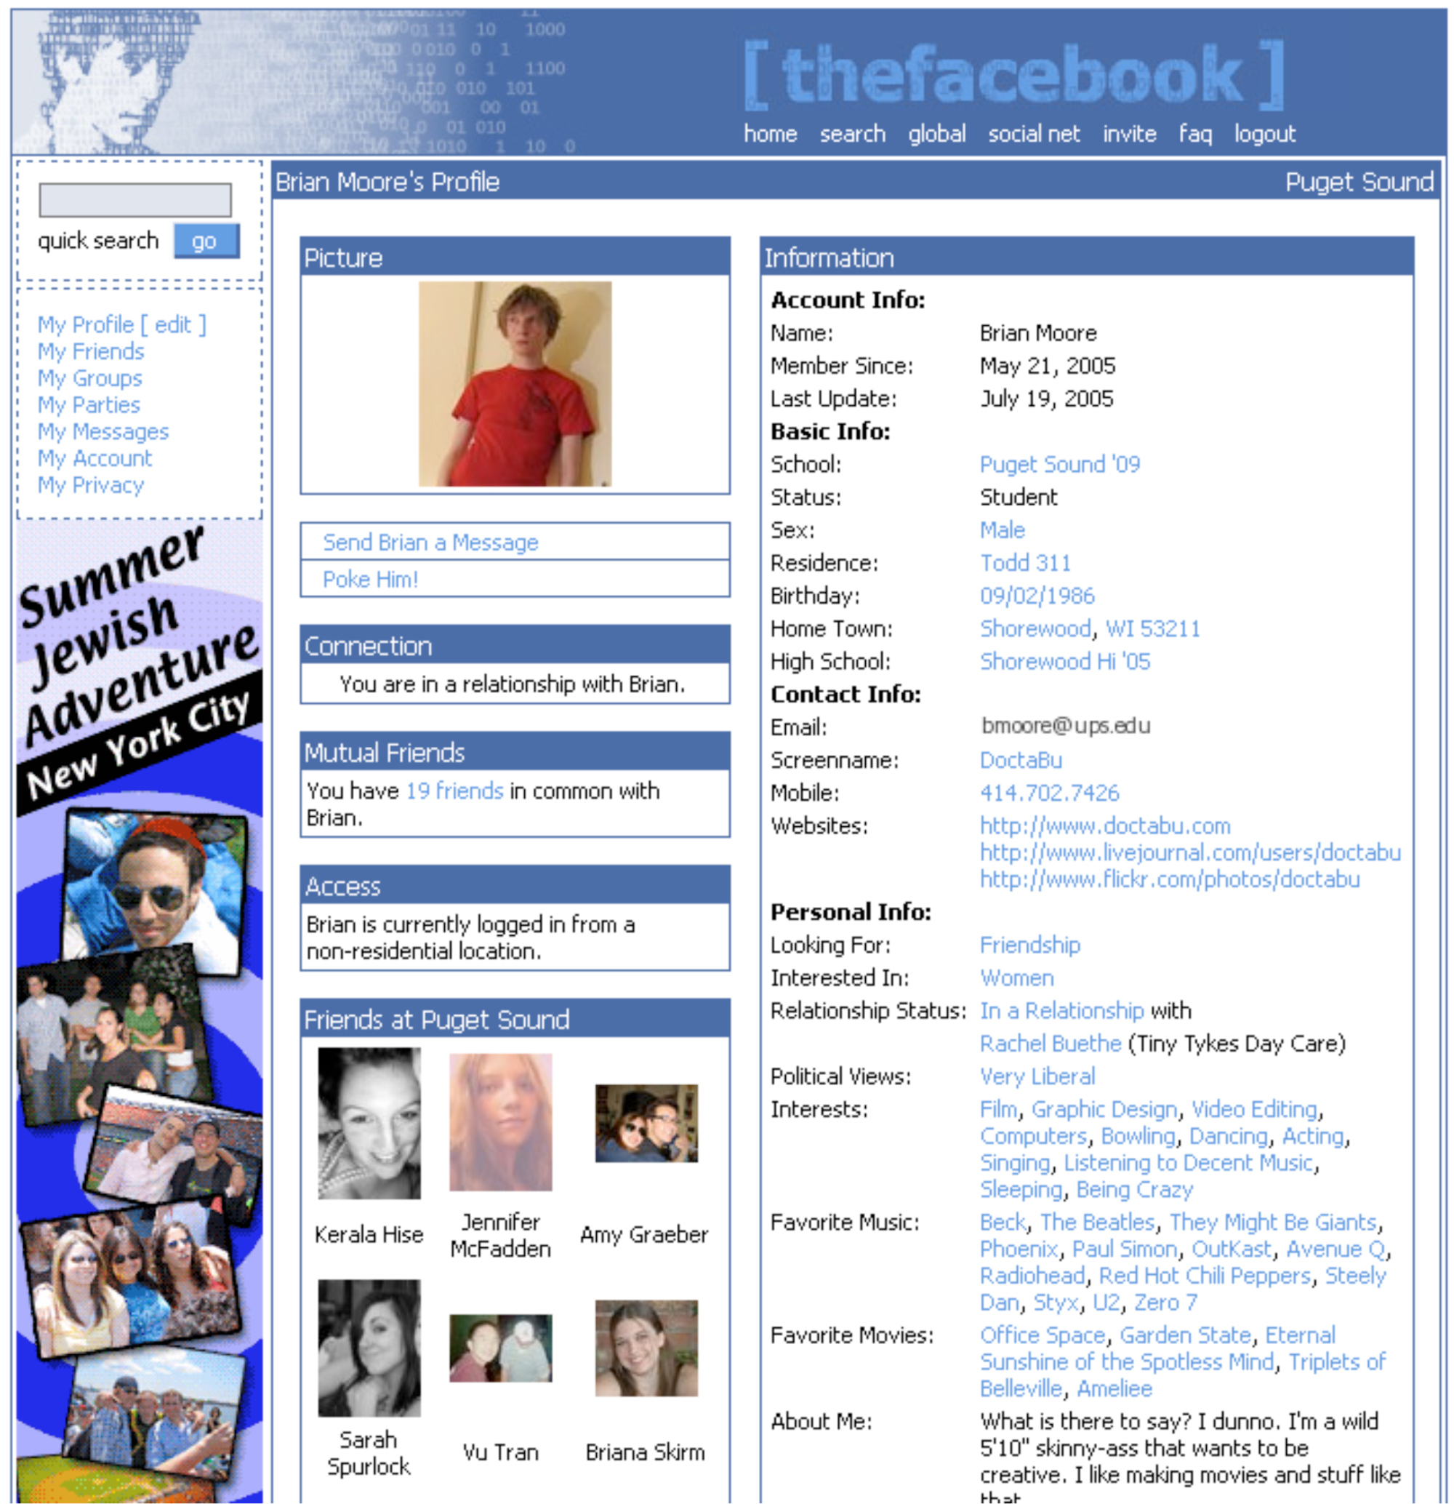
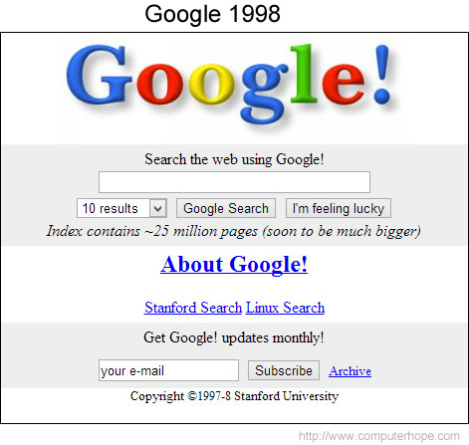
Internet of Information (Web 2.0)
Notes:
What is the concerns about such form of Internet?
Could you give us some examples?

Slide 5
Internet of Information
Limitation: Companies (banks or large tech companies) maintain its infrastructure and they extract a massive amount of data from us users
Exclusive
Data Privacy
Data Safety
Data Manipulation
Need a need protocol to regain the trust of information!

Slide 6
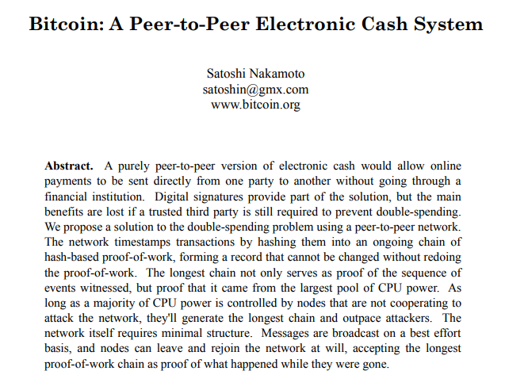
What is Blockchain
Released in October 2008
Anonymous

Slide 7
Blockchain Technology

Slide 8
Blockchain Structure
Blockchain is a chain of blocks
Each block contains data, the hash, the hash of the previous block, and a pointer to the previous block
Prev. Hash
Prev. Hash
Prev. Hash
H( )
Data
Data
Data
Hash
Hash
Hash

Slide 9
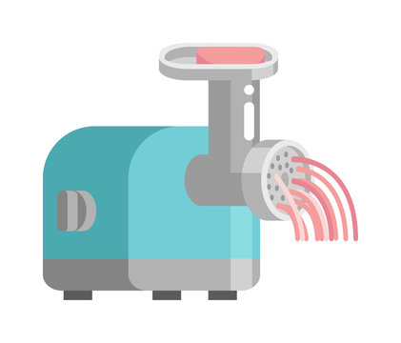
Basic Technologies – Hash Function
The Hash Function: A “one-way” function
Alice sent Bob 2.5 bitcoins
SHA-256
f1e7decf894e3fd8eb182f247fa13bfe82a0d667d3c91fe8f307c3b43b329960
Demo

Slide 10
Basic Technologies – Hash Function
If someone changes any part of a blockchain, then it is infeasible to make the chain consistent without changing the head pointer
One only need to check the head pointer to detect the tampering
Prev: H( )
Prev: H( )
Prev: H( )
Prev: H( )
H( )
Data
Data
Demo
Data
Data
Notes:
Password Storage as one of the application

Slide 11
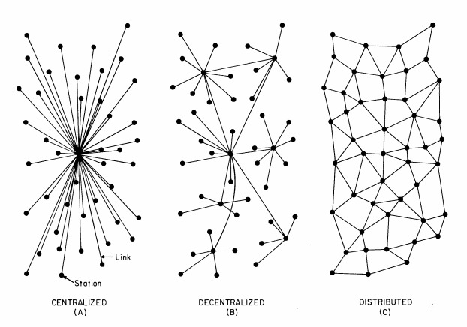
Blockchain Structure
It’s a digital distributed ledger

Slide 12
Basic Technologies – Consensus Mechanism
Proof of Work
Mission: Uncover the mystery number (nonce) that makes the resulting hash tinier than a specific target!
$$H\left(nonce\right|block in progress)<target$$
000000000000000000851acb652d32e4e8a9e29aa216d765ec686c18d0a3e250
The more zeros, the trickier the puzzle!
To find this hash, a miner needs to try on average ${16}^{18}∼5×{10}^{21}$ different nonces, or perform 5 billion terahashes!

Slide 13
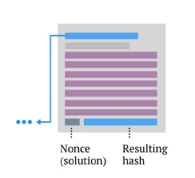
Basic Technologies – Consensus Mechanism
Proof of Work
When a miner finds a nonce that solves the problem, he/she wins the block and broadcasts the solution to the network
Demo

Slide 14
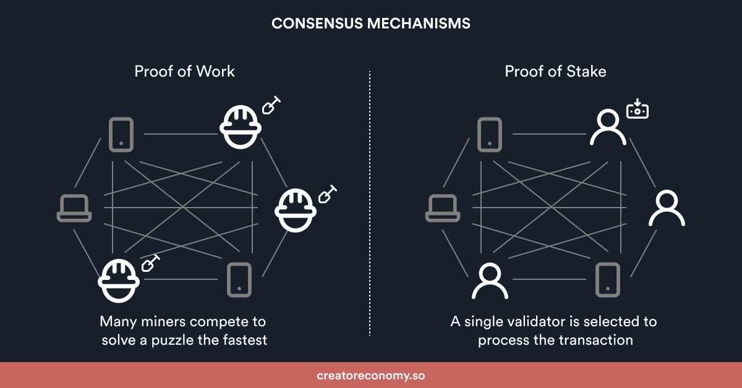
Basic Technologies – Consensus Mechanism
Proof of Stake

Slide 15
Blockchain Economics

Slide 16
The Economics of Blockchain
Decentralization
Proof of work or other consensus mechanism
Faster Settlement
24/7 without intermediary
Trust and Security
Hash Function, Distributed Ledger
Tokenization
Enables new assets and economic models

Slide 17
Crypto Assets: Bitcoin

Slide 18
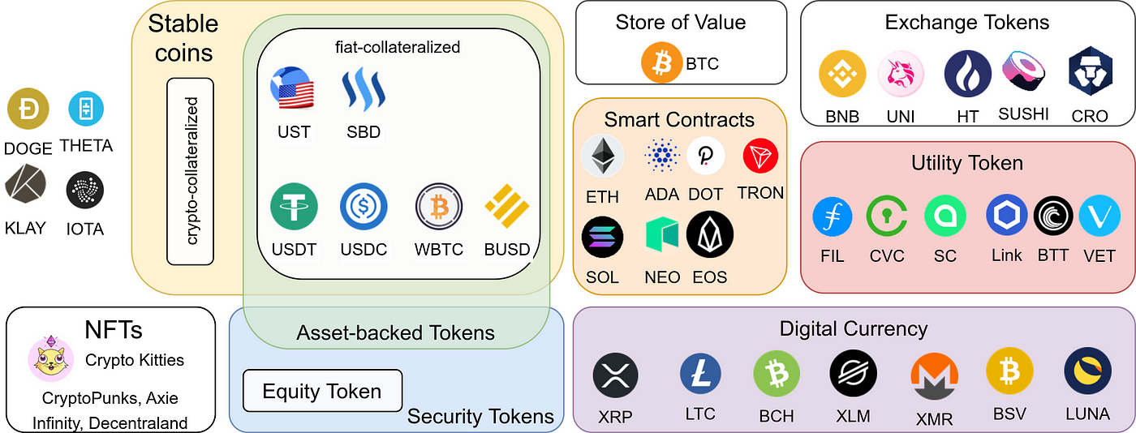
Tokenomics
Historical Trend
Current Rank

Slide 19
Types of Cryptos
Payment Token
Utility Token
Security Token
Crypto-collectibles (NFT)
…

Slide 20
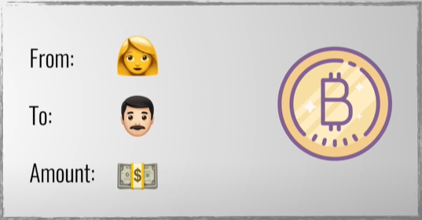
Payment Token
Bitcoin
A cryptocurrency that store the transaction data of bitcoin on the blockchain system

Slide 21
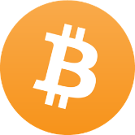
Payment Token
Bitcoin Transaction
Bob shares his public address with Alice via string or QR-code.
Alice enters Bob's address, the Bitcoin amount, and signs with her private key.
Alice broadcasts the transaction to the Bitcoin network—crypto magic!
Demo
Alice
Bob
1 BTC

Slide 22
Fundamental Value of Bitcoin
Self-Fulfillment Incentive
Validation
Development
Marketing

Slide 23
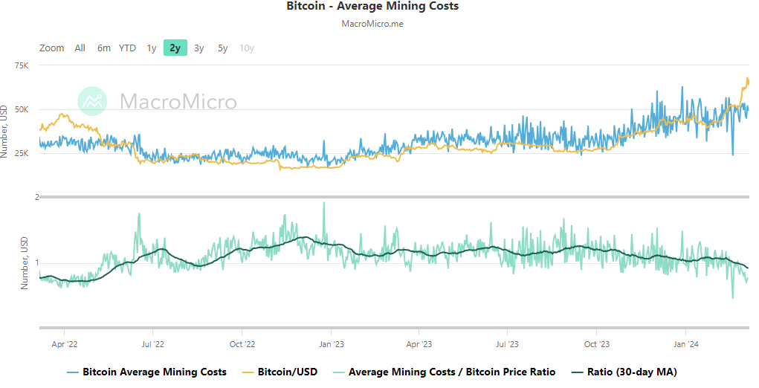
Fundamental Value of Bitcoin

Slide 24
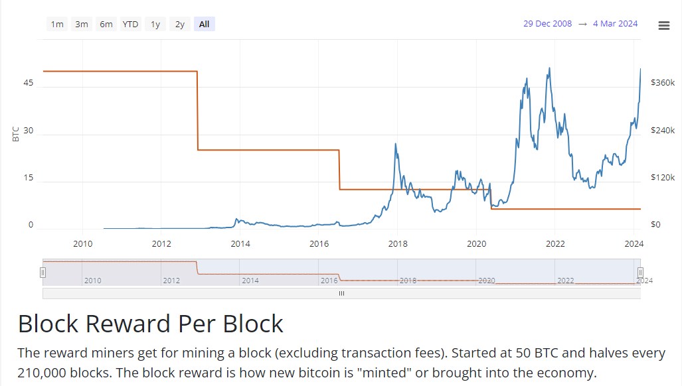
Fundamental Value of Bitcoin

Slide 25
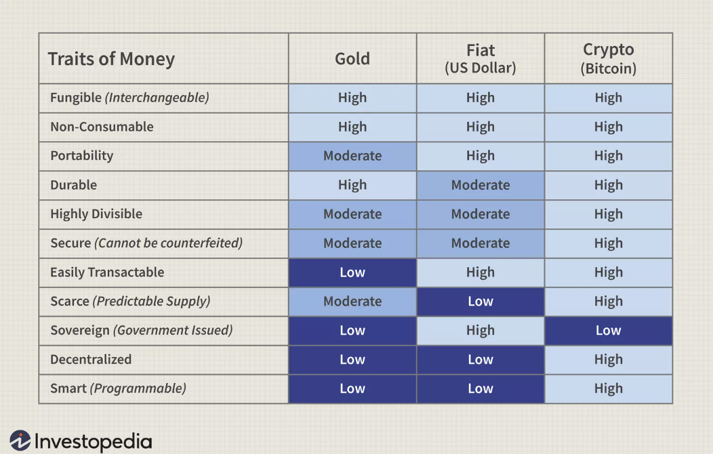
Fundamental Value of Bitcoin
Currency

Slide 26
Fundamental Value of Bitcoin
Safe-Haven Asset like gold

Slide 27
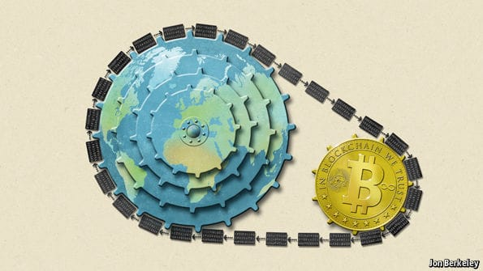
Fundamental Value of Bitcoin
Trust of Blockchain Potential (e.g., Bitcoin) – Industry Investment

Slide 28
Crypto Assets: Platform Currency

Slide 29
Utility Token
Ethereum
Founded by Vitalik Buterin in 2014
The most popular smart contract platform
Home base for countless ICOs and decentralized applications (dApps) that cover finance, gaming, art, and more!

Slide 30
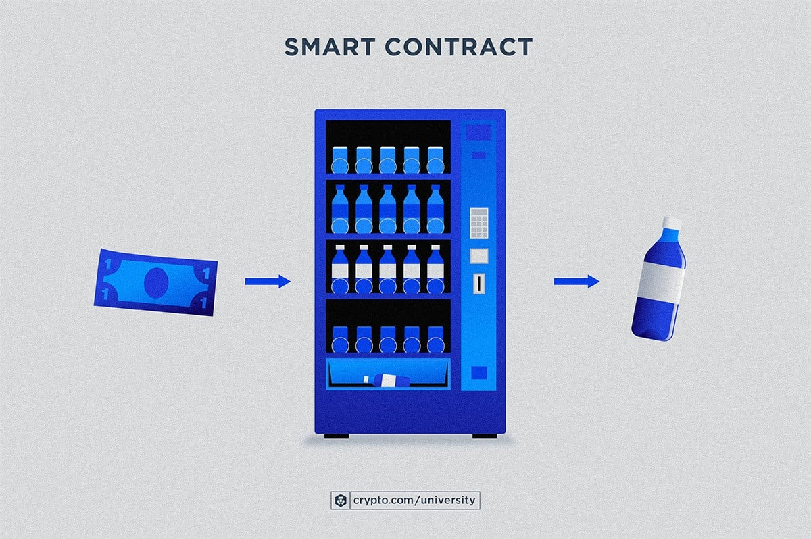
Basic Technologies – Smart Contract
Notes:
Accessible to everyone
No middlemen required
Auto execution
Stored in secure lockbox
Run on computer logic

Slide 31
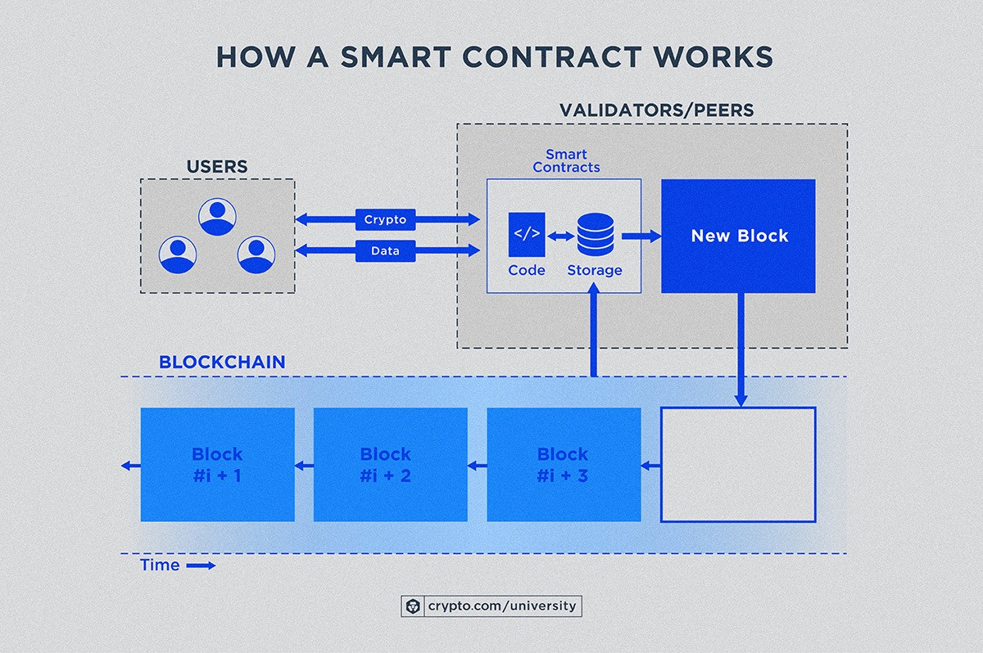
Basic Technologies – Smart Contract
Self-executing computer program that runs on a blockchain
Notes:
Benefits of smart contracts over traditional automation: Trustless execution, immutability, efficiency, lower costs, security, and interoperability

Slide 32
Utility Token
Ethereum
Tokens with specific powers inside a blockchain platform:
Unlock special features or services
Incentivize user contributions

Slide 33
Utility Token
BAT: The fastest ICO on Ethereum
Brave Browser – Basic Attention Token (BAT):
The ICO raised $36m via a token offering on the Ethereum Network. The offering raised 156,250 Ether in a mere 24 seconds!
The token can be used to obtain a variety of advertising and attention-based services on the Brave platform.
Notes:
https://basicattentiontoken.org/

Slide 34
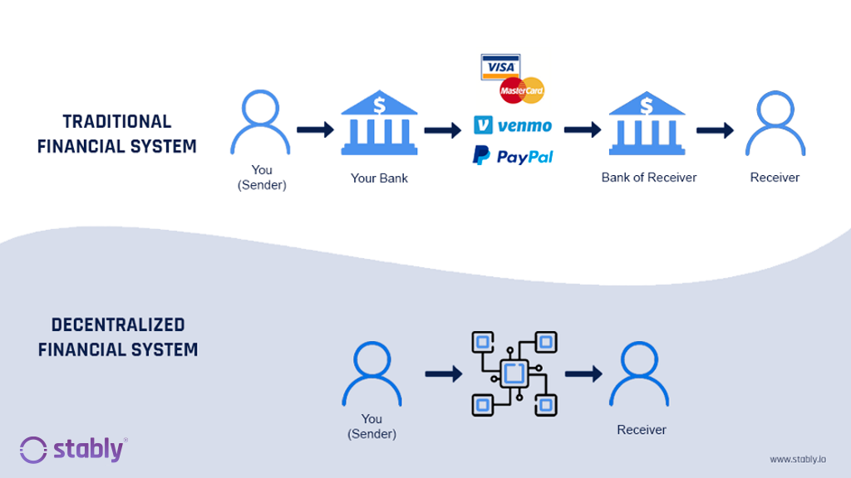
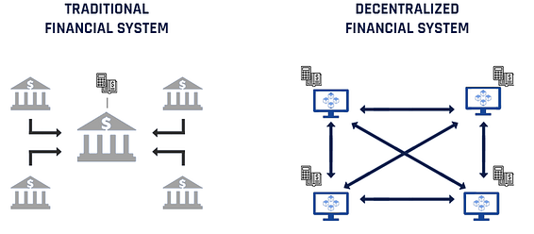
Decentralized Finance vs. Traditional Finance

Slide 35
DeFi (Decentralized Finance)
A financial system built on blockchain technology.
Bypasses traditional intermediaries (like banks).
Enables seamless, transparent, and secure financial services.
Example: Aave
A decentralized lending and borrowing platform.
Users can earn interest or borrow assets without banks.
Fully transparent and open-source.
Notes:
https://basicattentiontoken.org/

Slide 36
Crypto-collectibles (NFT)
Unique digital assets for digital or physical items:
Artwork, collectibles, or real estate
Built on platforms like Ethereum
Example:
CryptoKitties
Sandbox
CryptoPunk

Slide 37
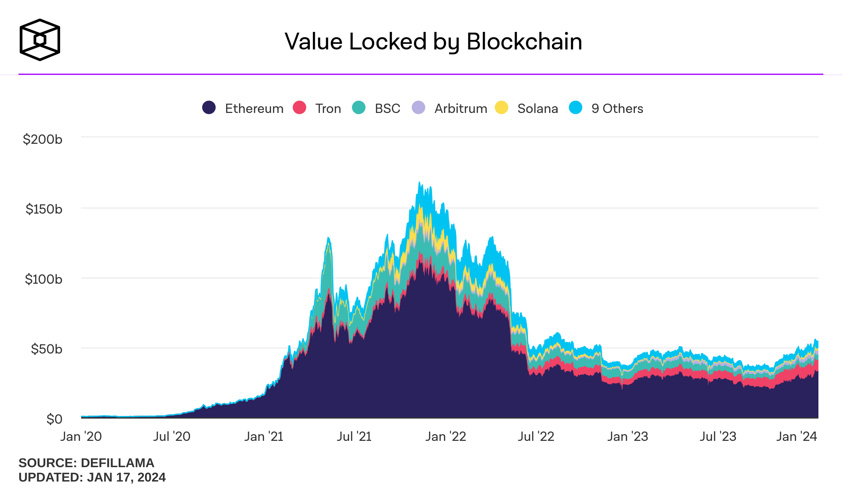
Fundamental Value of Platform Currency
Utilization of token
Active Developers
Total Value Locked (TVL)

Slide 38
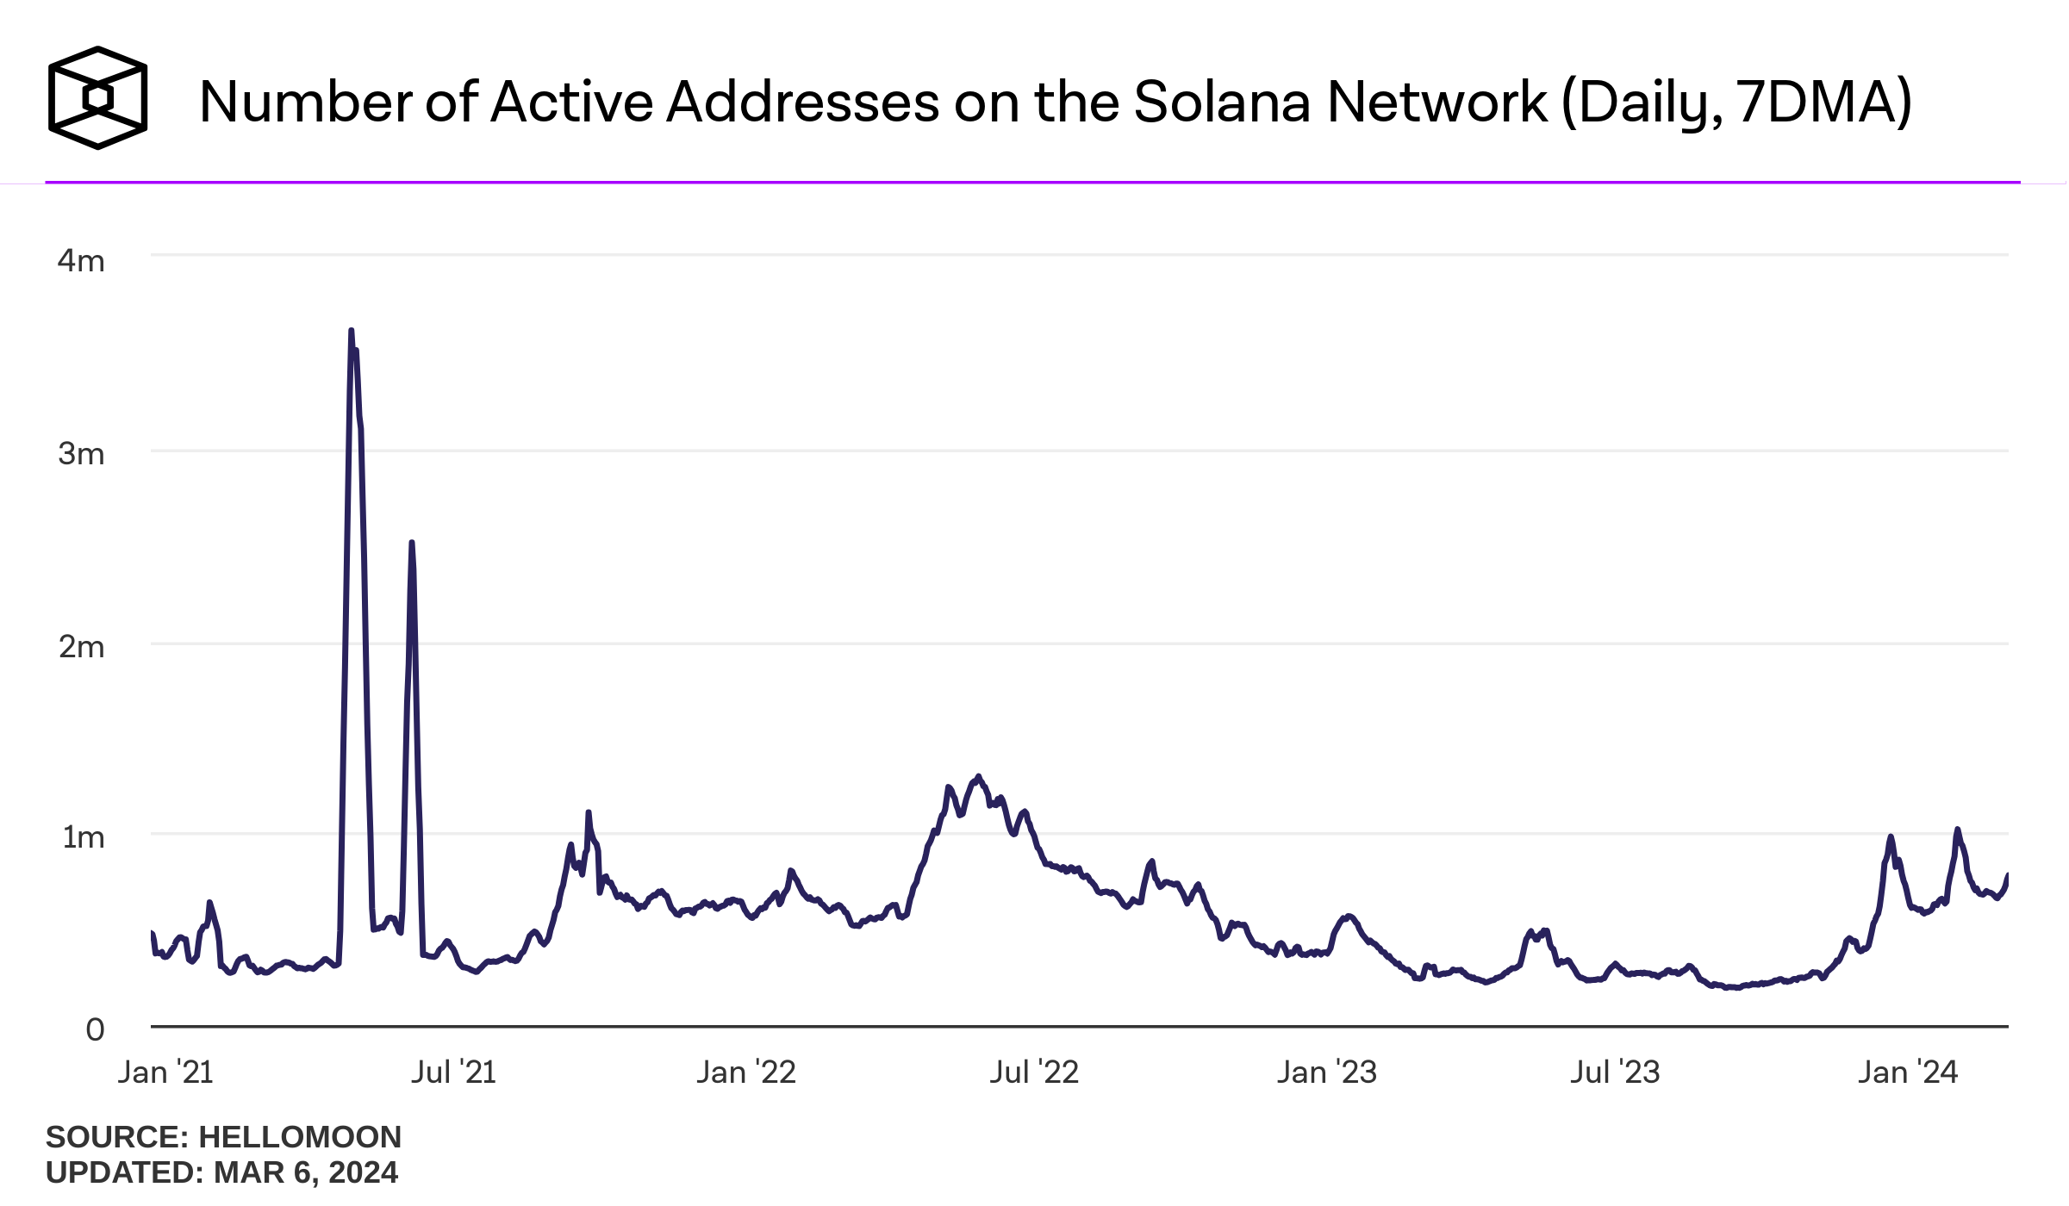
Fundamental Value of Platform Currency
Trust of Project Potential (e.g., Solana) – Stock Investment

Slide 39
Fundamental Value of Platform Currency
Backing Collateral (NFTs)
Metaverse, AI, and Blockchain

Slide 40
Future of Blockchain
The Internet of Things (IoT): Robot to Robot conversation through smart contract
Digital Assets Marketplace

Slide 41
Blockchain Challenge

Slide 42
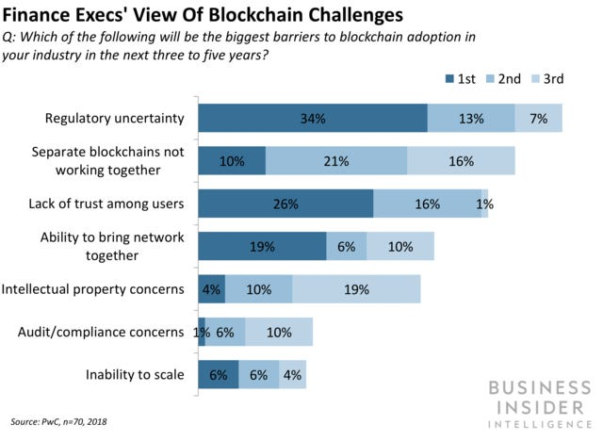
Challenge 1: Government Regulation

Slide 43
Challenge 2 : Not at the prime time
Still needs “killer” applications that are impactful
Bitcoin and Ethereum are the most successful ones and both face scalability issues
Applications in business are still mostly on test stages

Slide 44
Blockchain in Business

Slide 45
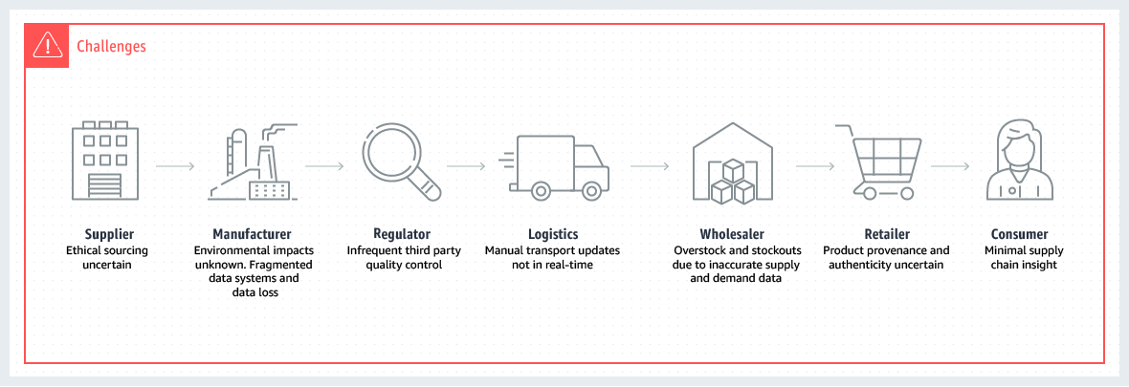
Challenges of Traditional Supply Chains

Slide 46
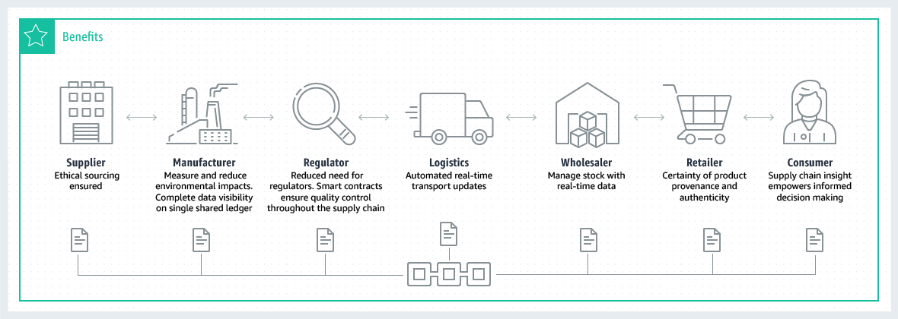
Benefits of Supply Chains with Blockchain

Slide 47
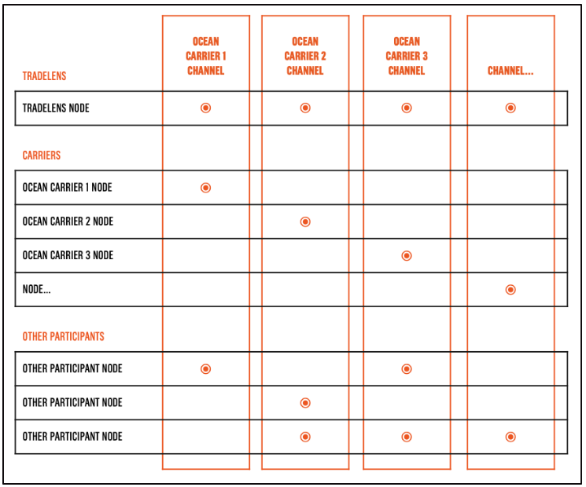
Application in Supply Chain

Slide 48
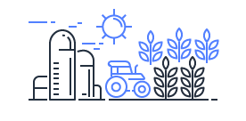
Industry Use Cases
Food and Agriculture
Food Safety
Access of the entire food product life cycle
Identify the source of contamination
Empower Customers and Sustainable Small Farmers
Allow small farmers to track their produce
Automation quicken the payment process
Connect customers directly with the source of food

Slide 49
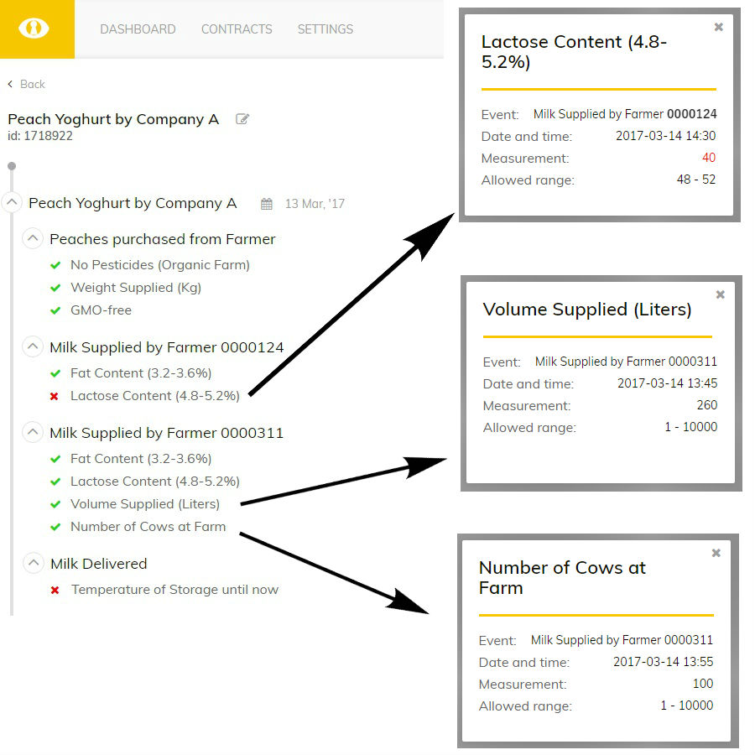
Industry Use Cases

Slide 50
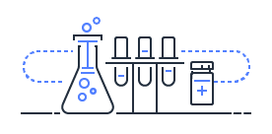
Industry Use Cases
Pharmaceuticals
Counterfeit Medicine
Check entire supply chain by serial numbers
Identify the weak points that present opportunity for counterfeit medicines
Medication Recalls
Identifying unsafe medications
Recalls associated with quality through automation

Slide 51
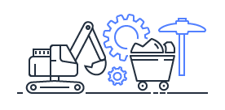
Industry Use Cases
Mining
Ethical Sourcing
Limit the opportunity for unethically sourced minerals like cobalt and tantalum to enter the supply chain
Ensure Authenticity
Ensure authentic and conflict free diamonds
Track record individual level details of the stone’s condition

